Slide 1

Computer Programming Language
A programming language is a computer language that is used by programmers (developers) to communicate with computers. It is a set of instructions written in any specific language ( C, C++, Java, Python) to perform a specific task.

Slide 2
Types Of Programming Language
Programming Language
Object Oriented Programming System
Complete Object Oriented Programming
Partially Object Oriented Programming
Procedure Oriented Programming System
Ex. C, VB 6.0
Ex, .Net, JAVA
Ex. C++, Python

Slide 3
Python
Python Is Partially Object Oriented High Level programming Language developed by Guido van Rossum in the year 1991. The following features made python popular now a days.
i) Easy to code
ii)Portable
iii) Free and Open Source
iv) Large Standard Library
v) Frontend and backend development

Slide 4
How To Install Python

Slide 5
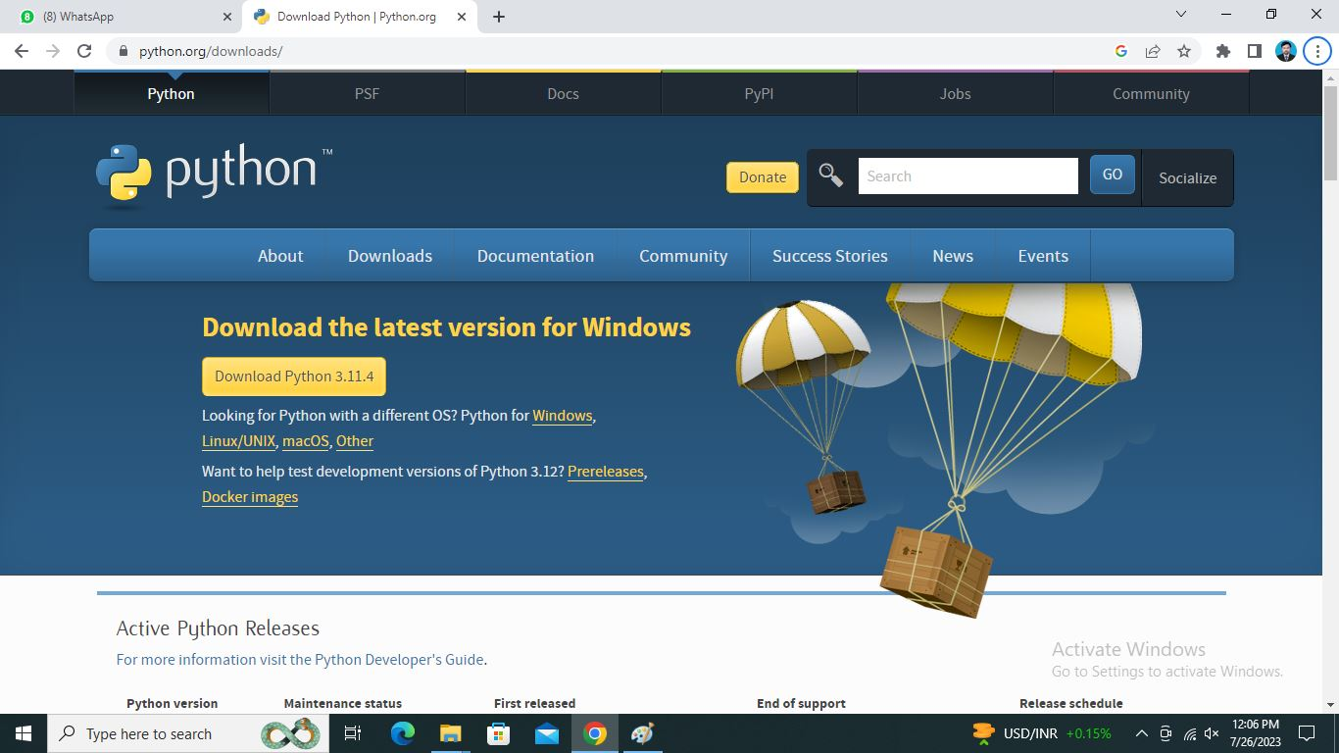
Visit The Following Website

Slide 6
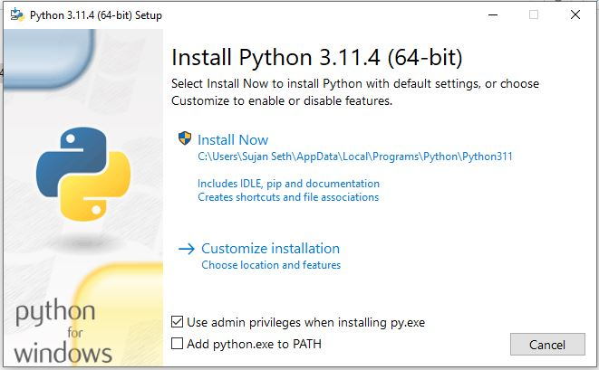
Install Python Compiler

Slide 7
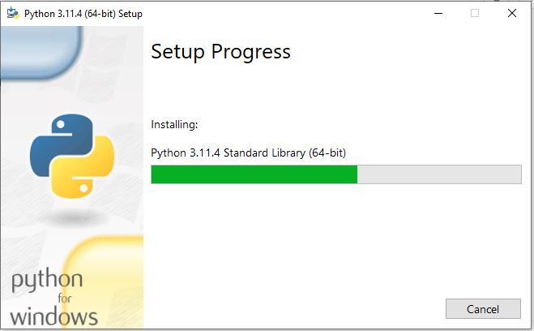
Set Up Progress

Slide 8
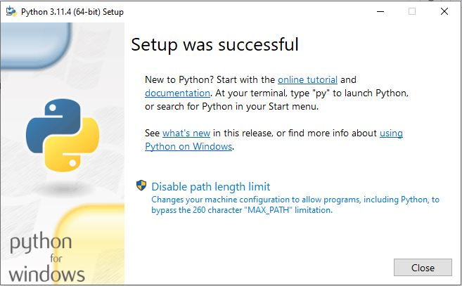
Complete The Setup

Slide 9
Variable Declaration And Memory Allocation
It is very Easy to declare variable in python, there is no specific command to declare variable in python, but you have to assign value into the variable at the time of declaration. The value might be assigned at runtime. The variable names are case sensitive. And we have to use print() function to get the output of the variable. Variable are of two types
1) Normal Variable
2) Global Variable
The variable that is declared inside the class that is called normal variable the variable that is called outside the class that is called Global Variable.

Slide 10
Part I
Python Data Types

Slide 11
Python Data Types
Integer (int)
Float
Array
String (str)
Boolean
List
Set
Tuple
Dictionary
None
Complex

Slide 12
Integer
Integer is a numeric data type. Like many other popular programming language python does not take any variable as an integer type. Rather we have to convert the data into integer type, while required. For that we have to use int() function.
Let us see some examples of integer programs.

Slide 13
Float
Float is a data type that uses fraction values. We have to use it while we are taking input as a float or while there is a possibility of being the output float.
By looking at these example we can easily understand the float data type.

Slide 14
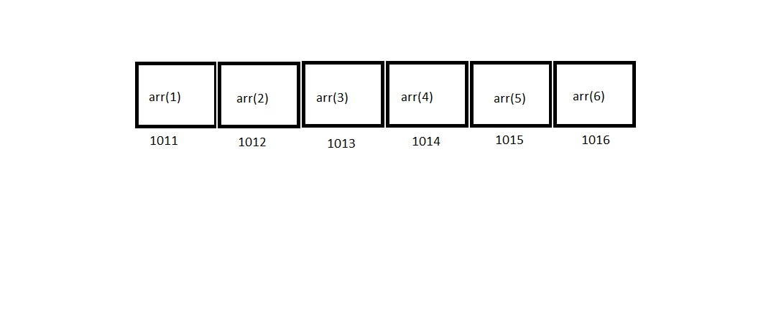
Array
Array is a collection of similar data type in a continuous memory location.
It is such a data type that uses another data type (Such as int or char) to define itself.
An array can be of two types
i) Static Array
ii) Dynamic Array
Take a look at the diagram given next slide about array types.

Slide 15
String
In python we have to write strings into single or double quotation marks. There is nothing specified, We can use both.
We can assign a string type data into a variable and we can use multiline string as well.
Lets us see some examples of string programs to understand this data type.

Slide 16
Type of Array
Static Array
Dynamic Array
Single Dimension Array
Multi Dimension Array or Matrix

Slide 17
Boolean Data Type
Boolean data type is such a data type that is used to represent logical expressions. Such as true false.
Let us see some examples about Boolean data types

Slide 18
Python List
A Python list is an ordered and changeable collection of data objects.
The collection that Although six Python data types can hold sequences, the List is the most common and reliable form. A list, a type of sequence data, is used to store the collection of data.
Let us see some examples about Python List

Slide 19
Python Touple
A tuple is a collection of objects which ordered and unchangeable.
Tuples are sequences, just like lists. The differences between tuples and lists are, the tuples cannot be changed unlike lists and tuples use parentheses, whereas lists use square brackets.
Let us see some examples about Python Touple

Slide 20
Python Set
A Python set is the collection of the unordered items. Each element in the set must be unique, unchangeable, and the sets remove the duplicate elements. Sets are mutable which means we can modify it after its creation.
Let us see some examples about Python Set

Slide 21
Python Dictionary
A dictionary is a collection which is ordered, changeable and do not allow duplicates.
A dictionary is, in other words, a group of key-value pairs, where the values can be any Python object. The keys, in contrast, are immutable Python objects, such as strings, tuples, or numbers. Dictionary entries are ordered as of Python version 3.7. In Python 3.6 and before, dictionaries are generally unordered.

Slide 22
NONE
The None keyword is used to define a null variable or an object. In Python, None keyword is an object, and it is a data type of the class NoneType . We can assign None to any variable, but you can not create other NoneType objects.

Slide 23
Complex
The Complex Data Type in Python is the data type that is used for representing complex numbers. As mentioned above a complex number is represented in the form of “a + bi’. In Python, we use the j or J suffix instead of i, for denoting the imaginary part of the complex number. For example, 3 + 3j.

Slide 24
Part II
Python Operators

Slide 25
Python Operators
Arithmetic operators
Assignment operators
Comparison operators
Logical operators
Identity operators
Membership operators
Bitwise operators

Slide 26
Arithmetic Operators
+ Addition x + y
- Subtraction x - y
* Multiplication x * y
/ Division x / y
% Modulus x % y
** Exponentiation x ** y
// Floor division x // y

Slide 27
Comparison Operators
Operator Name | Task | Example
> | Greater than: True if the left operand is greater than the right | x > y
< | Less than: True if the left operand is less than the right | x < y
== | Equal to: True if both operands are equal | x == y
!= | Not equal to – True if operands are not equal | x != y
>= | Greater than or equal to: True if left operand is greater than or equal to the right | x >= y
<= | Less than or equal to: True if left operand is less than or equal to the right | x <= y

Slide 28
Comparison operators
Operator | Description | Syntax
> | Greater than: True if the left operand is greater than the right | x > y
< | Less than: True if the left operand is less than the right | x < y
== | Equal to: True if both operands are equal | x == y
!= | Not equal to – True if operands are not equal | x != y
>= | Greater than or equal to: True if left operand is greater than or equal to the right | x >= y
<= | Less than or equal to: True if left operand is less than or equal to the right | x <= y

Slide 29
Logical operators
Operator | Description | Syntax
and | Logical AND: True if both the operands are true | x and y
or | Logical OR: True if either of the operands is true | x or y
not | Logical NOT: True if operand is false | not x
and | Logical AND: True if both the operands are true | x and y
or | Logical OR: True if either of the operands is true | x or y
not | Logical NOT: True if operand is false | not x

Slide 30
Identity Operator
is | Returns true if both variables are the same object | x is y
is not | Returns true if both variables are not the same object | x is not y

Slide 31
Bitwise Operator
Operator | Name | Description
& | AND | Sets each bit to 1 if both bits are 1
| | OR | Sets each bit to 1 if one of two bits is 1
^ | XOR | Sets each bit to 1 if only one of two bits is 1
~ | NOT | Inverts all the bits
<< | Zero fill left shift | Shift left by pushing zeros in from the right and let the leftmost bits fall off
>> | Signed right shift | Shift right by pushing copies of the leftmost bit in from the left, and let the rightmost bits fall off

Slide 32
Thank You very much for attending this presentation
If you have any question you are free to ask

